Slide 1




Microsoft identity platform
Doğan Erişen
Software Engineer
Developer community call
Deep dive on using MSAL.js to integrate React Single-page applications with Azure Active Directory
Salman Salem
Software Engineer
Kalyan Krishna
Product Manager
July 21, 2022 | 9:00AM PST
@kalyankrishna1

Slide 2


Introduction
First things first
Please note: We are recording this call so those unable to attend can benefit from the recording.
This call is designed for developers who implement or are interested in implementing Microsoft identity platform solutions.
What kind of topics will we discuss?
We will address development related topics submitted to us by the community for discussion.
We build a pipeline of topics for the next few weeks, please submit your feedback and topic suggestions - https://aka.ms/IDDevCommunityCallSurvey
View recordings on the Microsoft 365 Developer YouTube channel - https://aka.ms/M365PnP/videos
Follow us on Twitter @Microsoft365Dev and @azuread
This is NOT a support channel. Please use Stack Overflow to ask your immediate support related questions.
When is the next session?
Community Calls: Monthly – 3rd Thursday of every month

Slide 3
Agenda
Overview of MSAL.js and MSAL React
Using MSAL React in a React SPA
Enabling Single Sign-on
Acquiring a token for Microsoft Graph
Continuous Access Evaluation (CAE) Events
Deployment to Azure Static Web Apps
Next steps and references

Slide 4
Microsoft Authentication Libraries for JavaScript

Slide 5
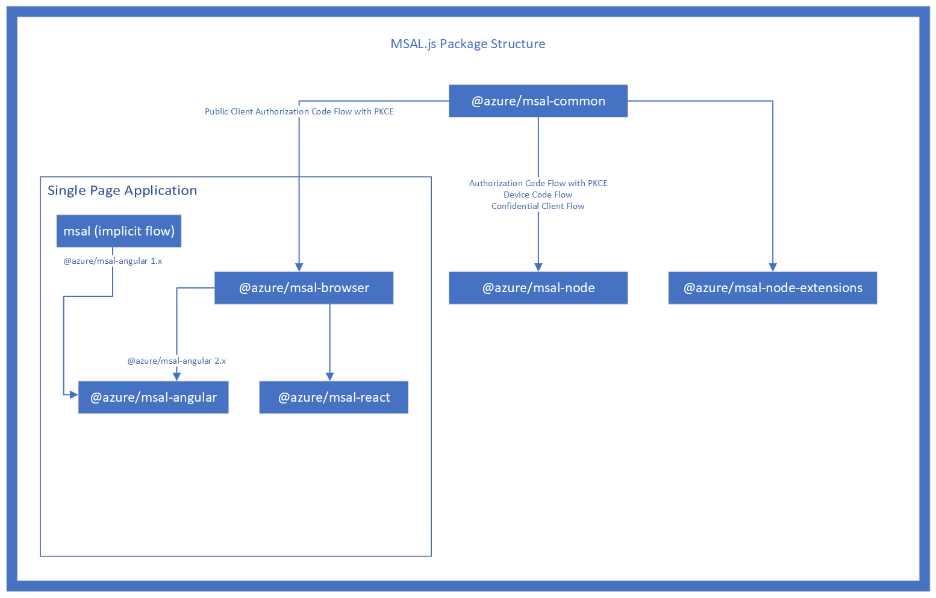
Client-side apps (public client)
Server-side apps (confidential client)
Authorization Code Grant with PKCE
Client Credentials Grant
Device Code Grant
On-behalf-of Grant
OpenID-compliant

Slide 6
MSAL React
OAuth 2.0 Authorization Code Grant with Proof Key for Code Exchange (PKCE)
React v16+ and later
React based frameworks: Next.js, Gatsby etc.
Supports server-side rendering (with some limitations)
Same public API with msal-browser
Adds templates, hooks and HOCs on top

Slide 7
Use MSAL React in your React applications

Slide 8
Use MSAL React in your React applications
Step 1: Register your app on Azure AD (portal.azure.com)
Step 2: Download a code sample or two (aka.ms/aadcodesamples)
Step 3: Start coding!
github.com/derisen/msal-react-demo

Slide 9
Prerequisites
Node.js v14+
An Azure Subscription
A GitHub account
github.com/derisen/msal-react-demo

Slide 10
Enabling Single sign-on

Slide 11
Single sign-on between multiple apps
SSO between tabs for the same app
Simply set msal’s cacheLocation to localStorage
SSO between different apps
ssoSilent method allows sign-in the user and obtain tokens without an interaction
if the user has multiple user accounts in a session with Azure AD, then the user is prompted to pick an account to sign in with
To bypass account selection screen, use a loginHint:
Session Id (sid)
login_hint (e.g. upn or preferred_username)
MSAL account object
If third-party cookies are blocked (e.g. Safari), ssoSilent will fail
InteractionRequiredAuthError: login_required: AADSTS50058: A silent sign-in request was sent but no user is signed in. The cookies used to represent the user's session were not sent in the request to Azure AD

Slide 12
Questions?

Slide 13
ID Token

Slide 14
Learn about and use claims provided in tokens
"aud": "66048303-7c4a-449f-b96d-9961bca5a8ce",
"iss": "https://login.microsoftonline.com/14c2f153-90a7-4689-9db7-9543bf084dad/v2.0",
"iat": 1639604770,
"nbf": 1639604770,
"exp": 1639608670,
"groups": [
"8303695c-1032-459c-8f05-d1fe424d2c3e",
"699f88b7-4e3d-458f-bef6-85e2661317a5", "a66f7d30-377a-46fa-8737-da59485e7cc5"
],
"name": "Admin user",
"oid": "5b6e08a5-7789-4ae0-a4cb-3d73b4097752",
"preferred_username": "administrator@kko365.onmicrosoft.com",
"roles": [
"Contributers",
"Writers"
],
"sub": "LiGWkvdwHuzmrCAw2feLvKoA70aq0F6er1FFsBpLEGU",
"tid": "14c2f153-90a7-4689-9db7-9543bf084dad",
"uti": "o5-ARrjdWk-aWWIjJhY2AA",
"ver": "2.0",
"wids": [
"62e90394-69f5-4237-9190-012177145e10",
"b79fbf4d-3ef9-4689-8143-76b194e85509"
This token was issued to your app Id
This token was issued in this tenant
The user belongs to these security groups
The only immutable identifier of a user/guest account in a tenant
This user belongs to these App roles
The tenant where this operation took place
The Azure AD roles assigned to this user
aka.ms/id-tokens
Notes:
Learn about the various claims available in the token and use their values to explicitly verify the user is who they claim and are allowed to operate on the application

Slide 15
Learn and use claims provided in tokens (guest)
"aud": "66048303-7c4a-449f-b96d-9961bca5a8ce",
"iss": "https://login.microsoftonline.com/14c2f153-90a7-4689-9db7-9543bf084dad/v2.0",
"iat": 1639606194,
"nbf": 1639606194,
"exp": 1639610094,
"acct": 1,
"groups": [
"8303695c-1032-459c-8f05-d1fe424d2c3e",
"699f88b7-4e3d-458f-bef6-85e2661317a5",
],
"idp": "https://sts.windows.net/72f988bf-86f1-41af-91ab-2d7cd011db47/",
"name": "Kalyan Krishna",
"oid": "3ad215f8-36a9-428e-ad9a-4de6fb6737c0",
"preferred_username": "kkrishna@kkaad.com",
"roles": [
"Contributers",
"Readers"
],
"sub": "UmqVDIF0q4z2tJXn3VKnaNdajhtxt4_lOjiCBxfnh0o",
"tid": "14c2f153-90a7-4689-9db7-9543bf084dad",
"uti": "Pu8bcGMepUCosBb1JZoxAA",
"ver": "2.0",
"wids": [
"62e90394-69f5-4237-9190-012177145e10",
"13bd1c72-6f4a-4dcf-985f-18d3b80f208a"
]
Request the acct optional claim to indicate home/guest user
This claim indicates it’s a guest user and has the tenantid of their home tenant
aka.ms/optionalclaims
Notes:
acct – Available as an optional claim, it lets you know what the type of user (home, guest) is.

Slide 16
Questions?

Slide 17
Configuring MSAL
Option | Description | Format | Default Value
clientId | App ID of your application. Can be found in your portal registration. | UUID/GUID | None. This parameter is required in order for MSAL to perform any actions.
authority | URI of the tenant to authenticate and authorize with. Usually takes the form of https://{uri}/{tenantid} | String in URI format with tenant - https://{uri}/{tenantid} | https://login.microsoftonline.com/common
knownAuthorities | An array of URIs that are known to be valid. Used in B2C scenarios. | Array of strings in URI format | Empty array []
redirectUri | URI where the authorization code response is sent back to. Whatever location is specified here must have the MSAL library available to handle the response. | String in absolute or relative URI format | Login request page (window.location.href of page which made auth request)
postLogoutRedirectUri | URI that is redirected to after a logout() call is made. | String in absolute or relative URI format. Pass null to disable post logout redirect. | Login request page (window.location.href of page which made auth request)
navigateToLoginRequestUrl | If true, will navigate back to the original request location before processing the authorization code response. If the redirectUri is the same as the original request location, this flag should be set to false. | boolean | true
clientCapabilities | Array of capabilities to be added to all network requests as part of the xms_cc claims request | Array of strings | []

Slide 18
Caching
MSAL Browser (and MSAL React) caches authentication artifacts in either:
Session storage (default)
Local storage
Memory storage
local storage and session storage are considered secure if applications do not have XSS (or similar) vulnerabilities (OWASP XSS Prevention Cheat Sheet)
Furthermore:
Short-lived tokens (1 hr for access tokens, 24 hr for refresh and id tokens)
Proof of Possession (currently only for access tokens, work-in-progress for refresh tokens)
Continuous Access Evaluation (CAE) events
cookie storage is also available to accommodate older browsers such as Internet Explorer

Slide 19
Authentication artifacts MSAL obtains from AAD
To faciliate a authN and authZ while maintaining a good UX, MSAL caches various artifacts:
Persistent auth artifacts
access tokens
id tokens
refresh tokens
accounts
Temporary auth artifacts
request metadata e.g. state, nonce, authority,
errors
interaction status
Telemetry
previous failed request
performance data

Slide 20
Logging
MSAL provides the ability to log authN/authZ activity at various levels of detail
Error
Warning
Info
Verbose
Trace
You can choose to log Personally Identifiable Information (PII) or not
MSAL also provides the ability to collect telemetry for your application

Slide 21
MSAL Events
Event Type | Description | Interaction Type | Payload | Error
LOGIN_SUCCESS | Successfully logged in | Popup or Redirect | AuthenticationResult
LOGIN_FAILURE | Error when logging in | Popup or Redirect |  | AuthError or Error
ACQUIRE_TOKEN_SUCCESS | Successfully acquired token from cache or network | Popup or Redirect or Silent | AuthenticationResult
ACQUIRE_TOKEN_FAILURE | Error when acquiring token | Popup or Redirect or Silent |  | AuthError or Error
LOGOUT_SUCCESS | Logout success | Redirect or Popup | EndSessionRequest or EndSessionPopupRequest
LOGOUT_FAILURE | Logout failed | Redirect or Popup |  | AuthError or Error
ACCOUNT_ADDED | Account logged-in in a different tab or window | N/A | AccountInfo | N/A
ACCOUNT_REMOVED | Account logged-out in a different tab or window | N/A | AccountInfo | N/A

Slide 22
Questions?

Slide 23
MSAL React Components

Slide 24
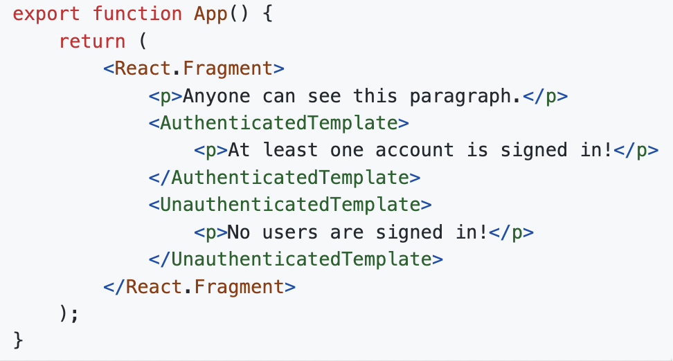
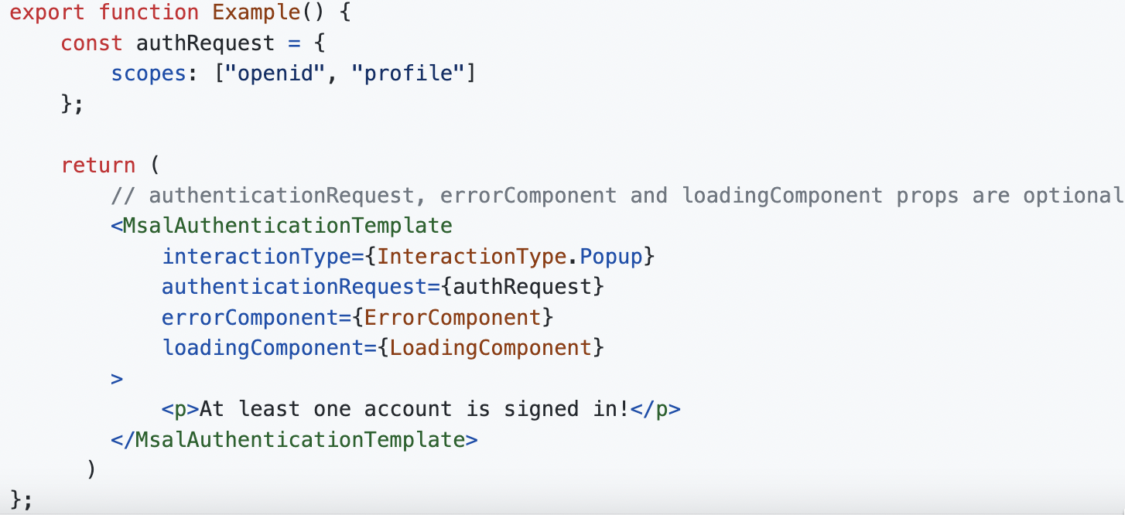
MSAL React Templates
AuthenticatedTemplate/UnauthenticatedTemplate
MsalAuthenticationTemplate

Slide 25
MSAL React Hooks
Name | Description
useMsal | The useMsal hook returns the context. This can be used if you need access to the PublicClientApplication instance, the list of accounts currently signed in or if you need to know whether a login or other interaction is currently in progress.
useIsAuthenticated | The useIsAuthenticated hook returns a boolean indicating whether or not an account is signed in. It optionally accepts an accountIdentifier object you can provide if you need to know whether or not a specific account is signed in.
useMsalAuthentication | The useMsalAuthentication hook will initiate a login if a user is not already signed in, otherwise it will attempt to acquire a token.
useAccount | The useAccount hook accepts an accountIdentifier parameter and returns the AccountInfo object for that account if it is signed in or null if it is not

Slide 26
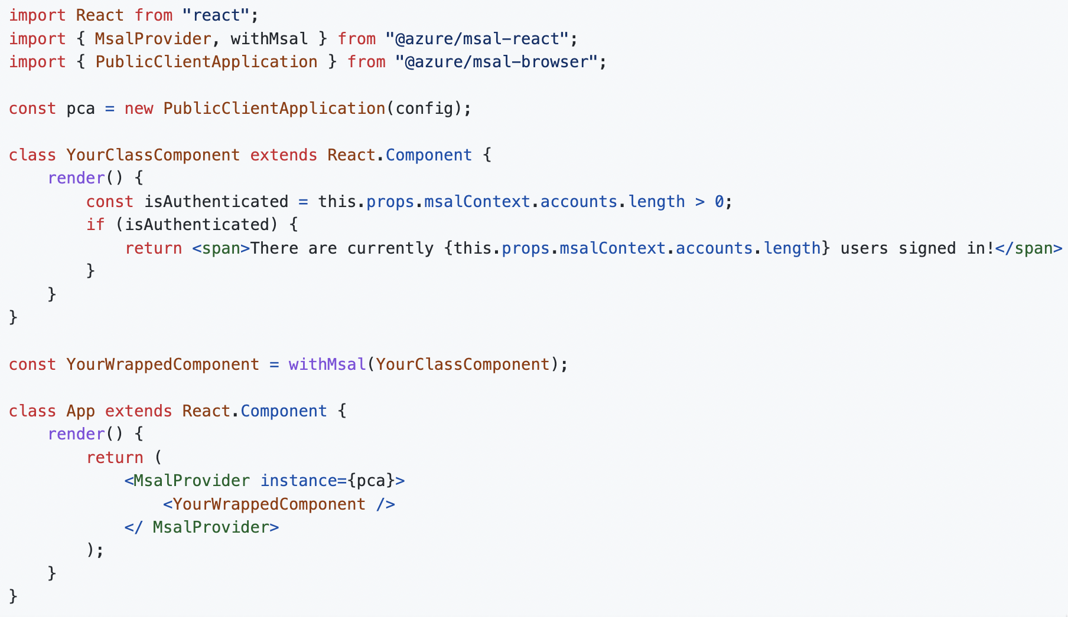
MSAL React withMsal HOC

Slide 27
Get an access token for Microsoft Graph

Slide 28
Questions?

Slide 29
Continuous Access Evaluation (CAE)

Slide 30
Continuous Access Evaluation (CAE)
CAE introduces real time enforcement of account lifecycle events and policies:
Account revocation
Account disablement/deletion
Password change
User Location change
User risk increase
Tenant admins are being encouraged to enable CAE in their tenants
Developers need to explicitly add support for CAE in their apps.
Learn about claims challenge and client capabilities - aka.ms/ClaimsChallenge

Slide 31
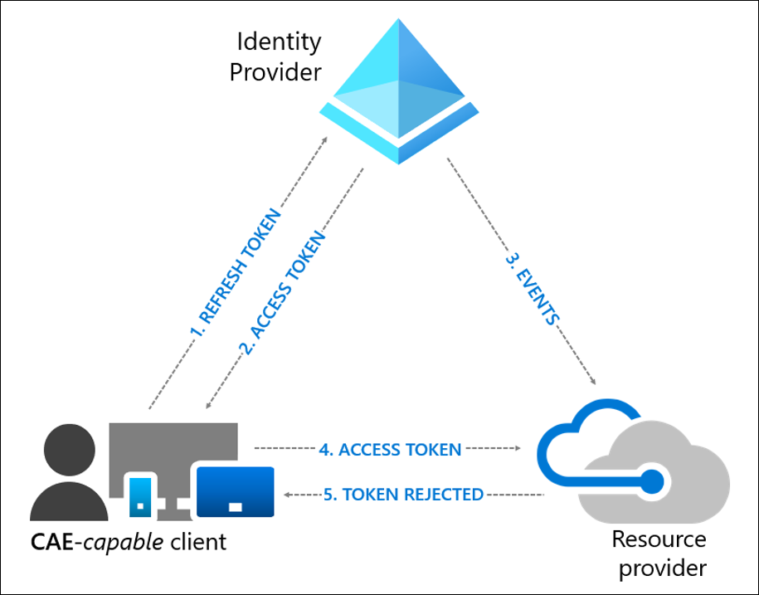
Handling CAE Challenges
Continuous Access Evaluation (CAE) is an Azure AD feature that allows access tokens to be revoked based on critical events and policy evaluation rather than relying on token expiry based on lifetime.
HTTP 401;
Unauthorized WWW-Authenticate=Bearer authorization_uri="https://login.windows.net/common/oauth2/authorize",
error="insufficient_claims",
claims="eyJhY2Nlc3NfdG9rZW4iOnsibmJmIjp7ImVzc2VudGlhbCI6dHJ1ZSwgInZhbHVlIjoiMTYwNDEwNjY1MSJ9fX0=”

Slide 32
Steps to handle CAE challenges
Step 1: Configure your MSAL app to declare that it’s capable of handling claim challenges
Step 2: Grab the www-authenticate header from the 401 response
Step 3: Process the header
Step 4: Pass the claims challenge to MSAL as a request parameter

Slide 33
Questions?

Slide 34
Deployment to Azure Static Web Apps

Slide 35
Deploying to Static Web Apps
Azure Static Web Apps is a service that automatically builds and deploys full stack web apps to Azure from a code repository:
Web hosting for static content like HTML, CSS, JavaScript, and images.
Globally distributed static content, putting content closer to your users.
First-class GitHub and Azure DevOps integration where repository changes trigger builds and deployments.
Integrated API support provided by Azure Functions with the option to link an existing Azure Functions app using a standard account.
Free SSL certificates, which are automatically renewed.
Back-end routing rules enabling full control over the content and routes you serve.

Slide 36
Q & A

Slide 37
More information
Get a free Azure AD tenant
MSAL.js on GitHub
MSAL Browser docs
MSAL React docs
MSAL React samples:
Testing samples
Chapterwise tutorials
Microsoft identity platform:
OAuth 2.0 Authorization Code Grant
Single Sign-on with MSAL.js
Continuous Access Evaluation
MSAL Code samples
OWASP XSS Prevention Cheat Sheet

Slide 38
Thank you
Recording will be available soon on the
Microsoft 365 Community (PnP) YouTube channel
https://aka.ms/M365PnP/videos
(subscribe today)
Follow us on Twitter
@Microsoft365Dev and @azuread
Next call: August 22nd at 9:00am PT
https://aka.ms/IDDevCommunityCalendar

